Slide 1
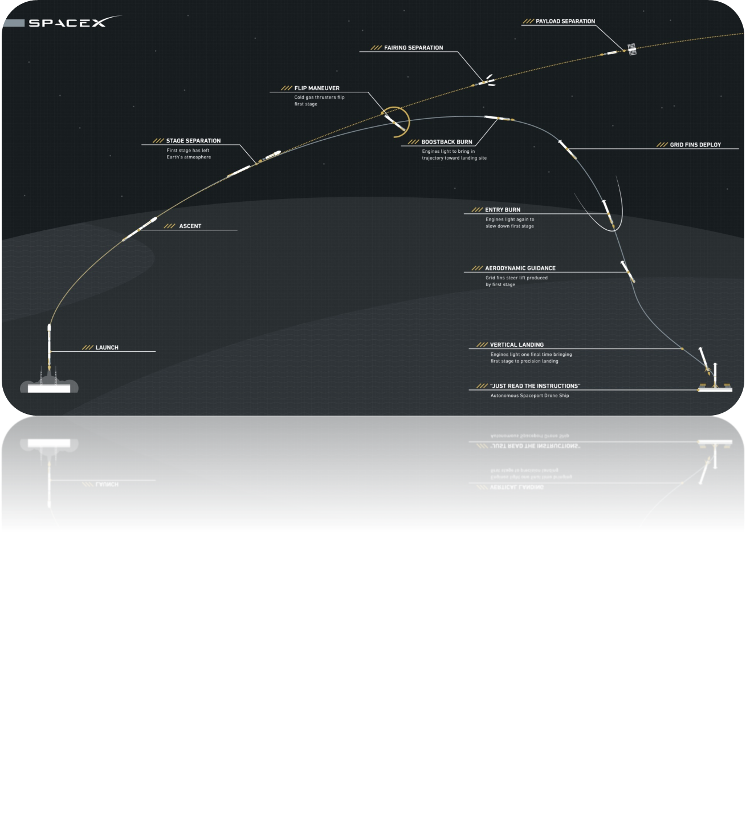
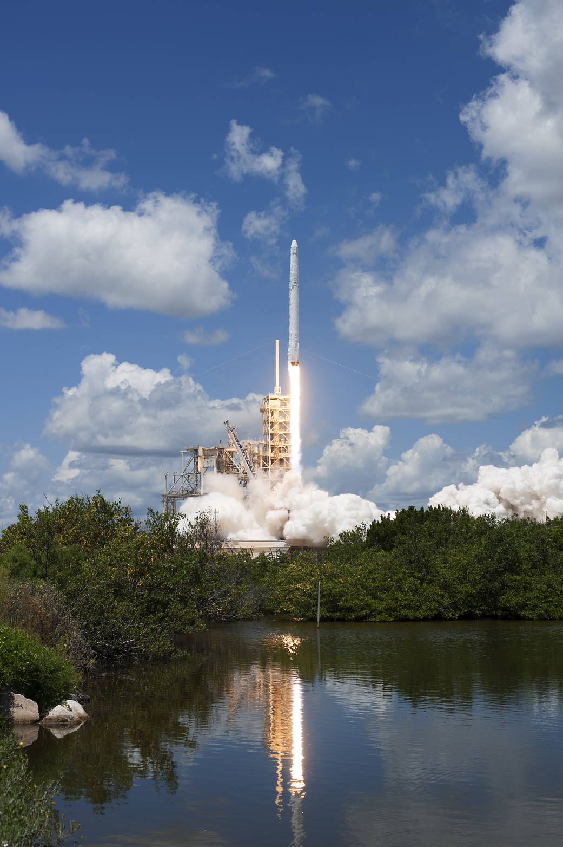
Title of the poster (Aerial font 60 size)
INTRODUCTION (Aerial 48 size)
RESULTS (Aerial 48 size)
SpaceX is committed to revolutionizing access to space by providing highly reliable, low cost launch services. To this end, SpaceX has been developing a family of orbital transportation solutions comprised of SpaceX-developed proprietary technologies, as well as off-the-shelf and minimally modified hardware from leading aerospace subcontractors. SpaceX is currently offering launch services on the Falcon 1, Falcon 9, and Falcon 9 Heavy launch vehicles as well as commercial flights on the Dragon spacecraft. Founded in mid-2002, SpaceX has been busy. This paper provides the latest developments and progress, including recent launches and future plans.
According to a launch cost analysis by investment firm Jefferies International, SpaceX usually makes a 40 percent profit from $62 million commercial Falcon 9 launches with new boosters. That puts $25 million in the bank and $37 million toward direct launch costs.
Space Exploration Technologies Corp., doing business as SpaceX, is a private American aerospace manufacturer and space transportation services company headquartered in Hawthorne, California. It was founded in 2002 by entrepreneur Elon Musk with the goal of reducing space transportation costs and enabling the colonization of Mars. SpaceX has since developed the Falcon 9 launch vehicle family and the Dragon spacecraft family, which both currently deliver payloads into Earth orbit.
NOVELTY/ COMMERCIAL POTENTIAL (Aerial 48 size)
SpaceX says that it costs $62 million every time its Falcon 9 rocket is launched, while the more powerful Falcon Heavy costs an estimated $90 million per launch. (SpaceX even says customers can get cheaper rates if they buy in bulk: “Modest discounts are available, for contractually committed, multi-launch purchases”).
OBJECTIVES & METHODS (Aerial 48 size)
REFERENCES (Aerial 48 size)
[1] S. Shafiee and E. Topal, “When will fossil fuel reserves be diminished?,” Energy Policy, vol. 37, no. 1, pp. 181–189, 2009.
[2] S. Suranovic, “Fossil fuel addiction and the implications for climate change policy,” Glob. Environ. Chang., vol. 23, no. 3, pp. 598–608, Jun. 2013.
It was founded in 2002 by entrepreneur Elon Musk with the goal of reducing space transportation costs and enabling the colonization of Mars. SpaceX has since developed the Falcon 9 launch vehicle family and the Dragon spacecraft family, which both currently deliver payloads into Earth orbit.
S.Sai Krishna 16N31A03E8 | B.Sai Priya Reddy 15N31A0324
B.Shiva Sai Kiran 15N31A0325 | Guide

